Slide 1
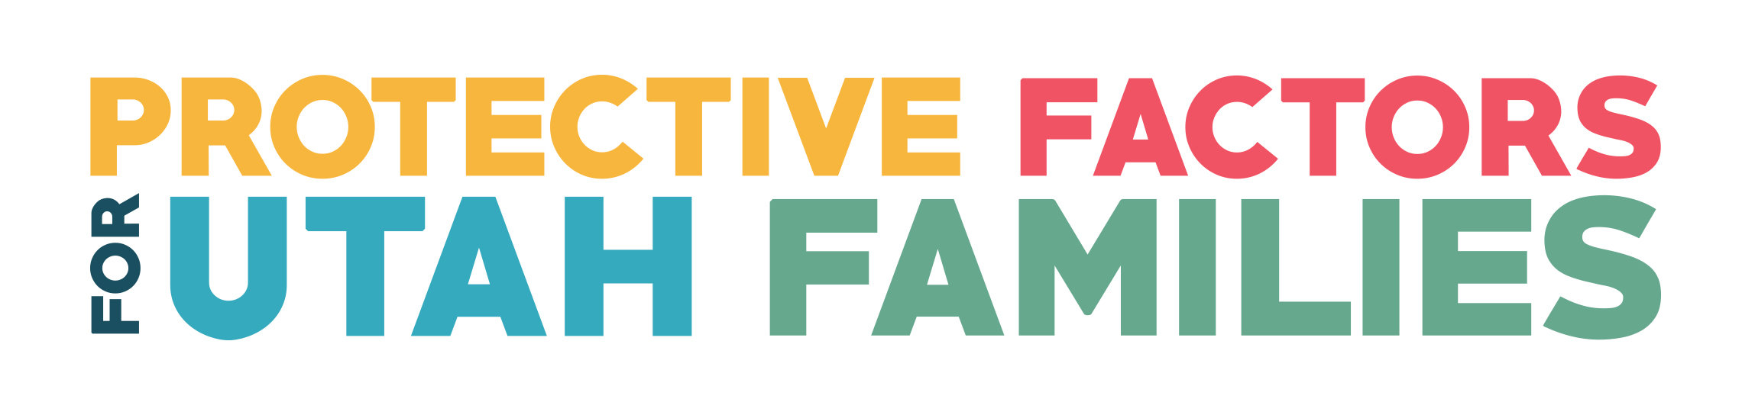


Reducing the effects of trauma:
Youth Thrive: A Framework to Support success
USBE Adult Education & Youth in care fall conference
September 27, 2019

Slide 2
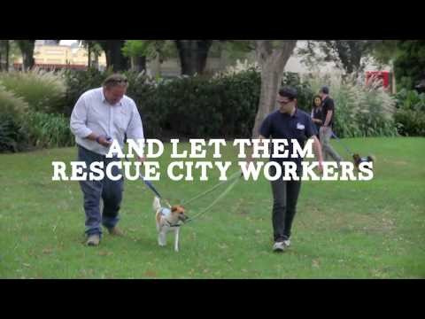
“A Different Lens”

Slide 3

Strength-Based Theory:
Looking at Families and youth Through a Different Lens
Focus on what’s strong, not what’s wrong!
Notes:
Discussion on Strength-Based Theory (p.5) -- paragraph one

Slide 4
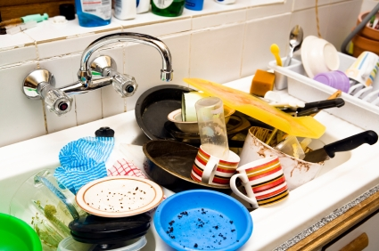
Training Your Brain to See A Different Perspective
Focus on the picture below and see how many descriptions, phrases, labels you can come up with in 30 seconds (ignore grammar – go for speed!)
+3 points for every positive (and true) descriptor and +1 for every negative one
Research shows that people who have a positive to negative ratio of 3:1 are more optimistic and happier.
Try to balance every piece of bad news with 3 pieces of good news.
Seek out the positives!

Slide 5
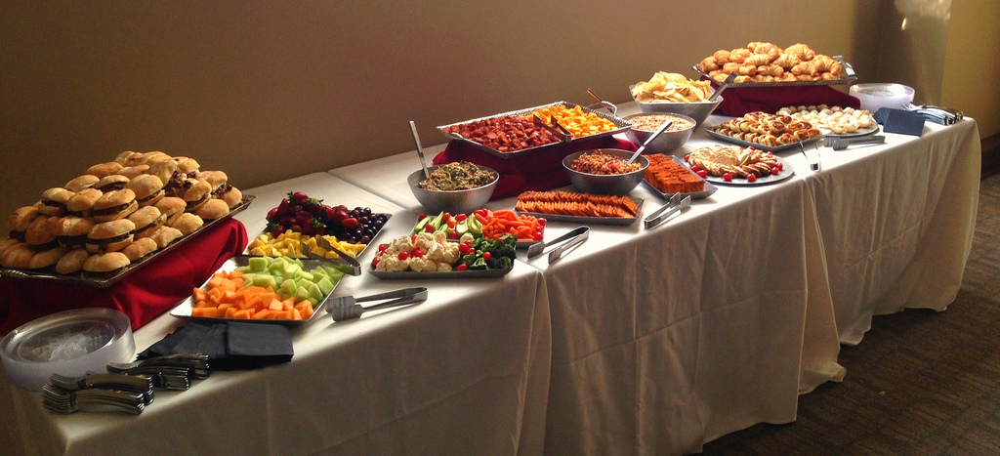
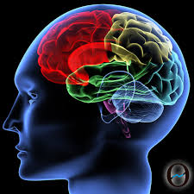
Your Reality is Your Choice
The human brain receives 11 million pieces of information every second from our environment, but can only process 40 bits per second.
We get to choose what we focus on and what to dismiss or ignore (but our brains are wired to focus on threats!)
Your reality is a choice – what you choose to focus on shapes how you see and understand your world.
The Tradeoff:
I think about negatives, and the less positives I see….OR
Change my mindset and choose to think about more positives around me!
Notes:
“Our greatest weapon against stress is our ability to choose one thought over another” – William James
Did you know that our brains are bombarded with 11 million pieces of information every second, but can only process 40 bits per second? The rest of the information is either processed by our unconscious brain or eliminated as “spam”. So our brains have to actively decide what to toss out and what to listen to and absorb.
We can choose either to hear negative, flawed, or irrelevant information or absorb information that will help us accomplish our goals. But because the amount we focus on is limited, there is a trade-off; the more negative information we take in, the less positive signal we can hear, and vice versa. But we are wired to notice and pay attention to negativity. In fact, we have five times as many neural connections wired for fear than for searching for opportunities. For example, if your child came home from school with 5 A’s and 1 D. What do you immediately focus on? Why?
This is important because the better your brain is at using its energy to focus on the positives, the greater your chances are at being able to see strengths instead of weakness, and build helpful relationships with kids. But it takes a change in mindset.
(click to advance) Think of it as a buffet and there are 11 million choices. You get to choose only 40 of those to try. Deciding what to eat is a choice, and so is choosing to what to think.

Slide 6
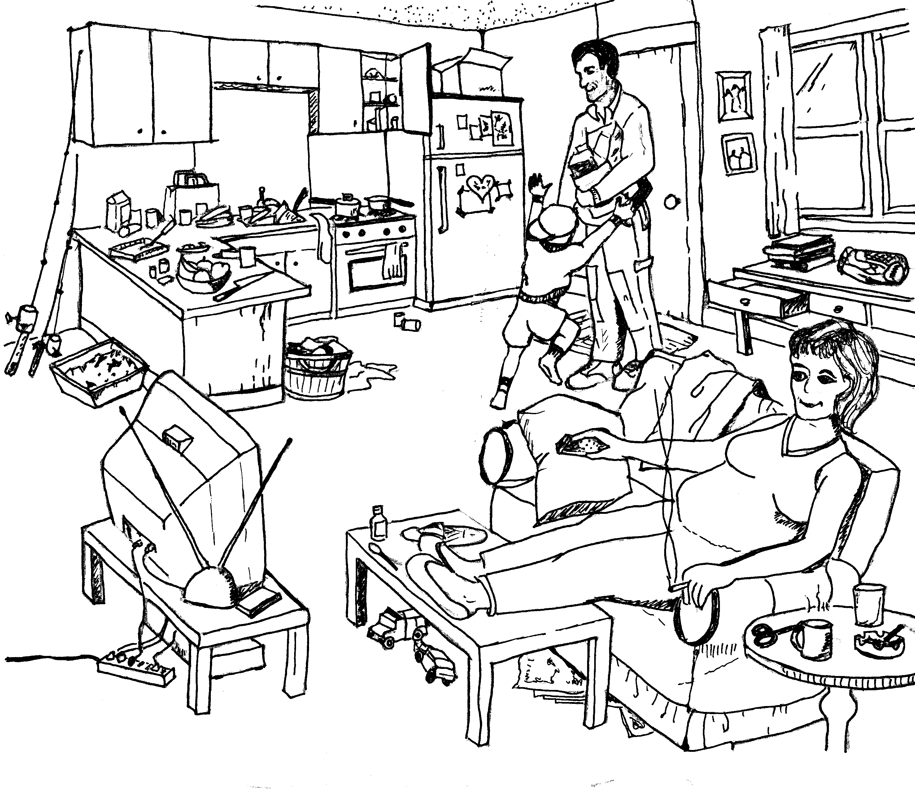
Risk and Protective Factors Cartoon
Notes:
Discussion on Strength-Based Theory (p.5)
Activity: Changing Our Focus – Risk/Protective Factors Cartoon (p.5)

Slide 7
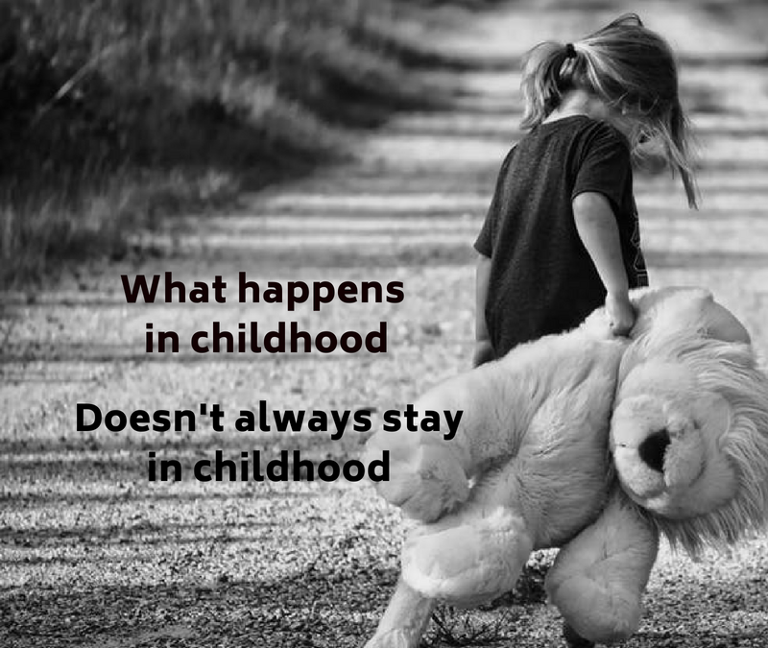
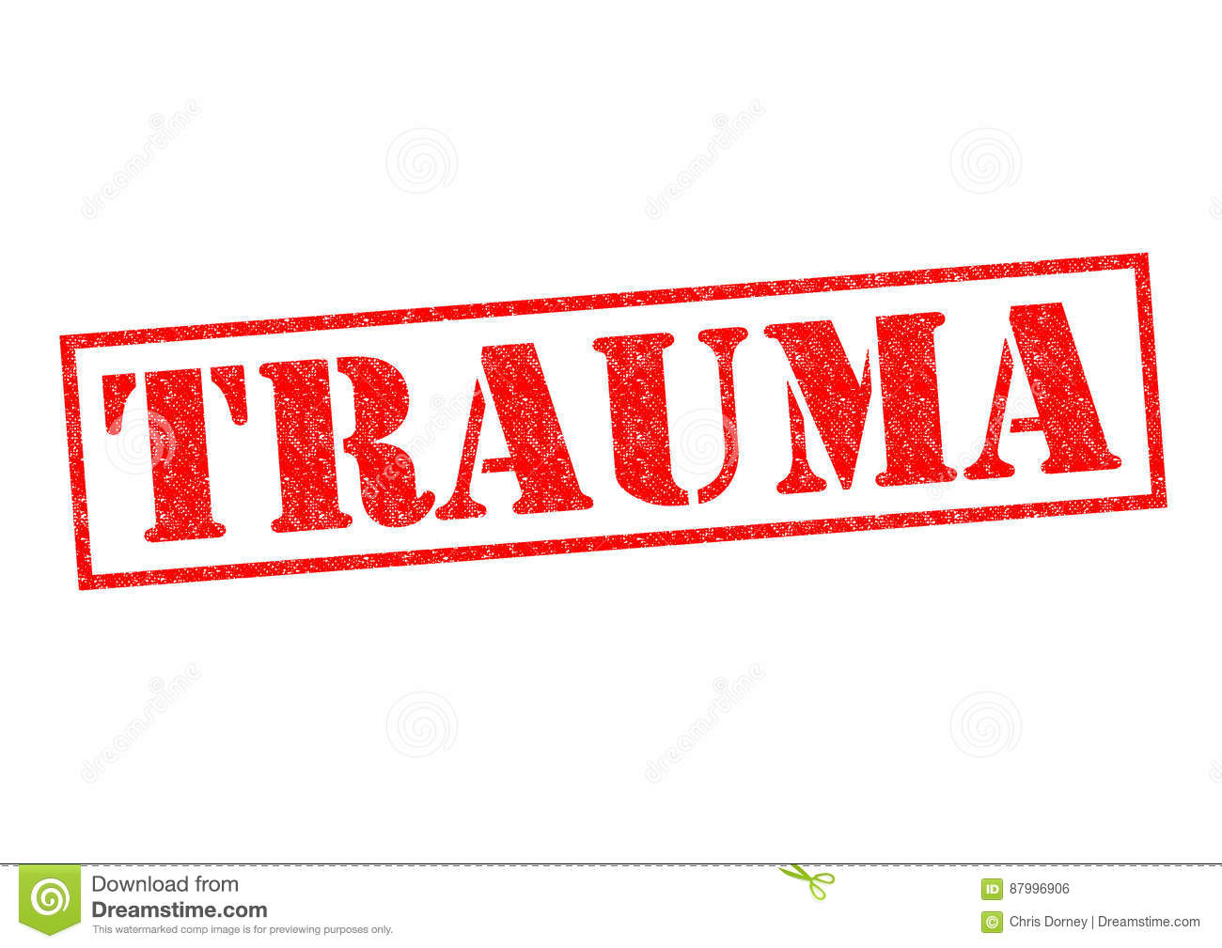
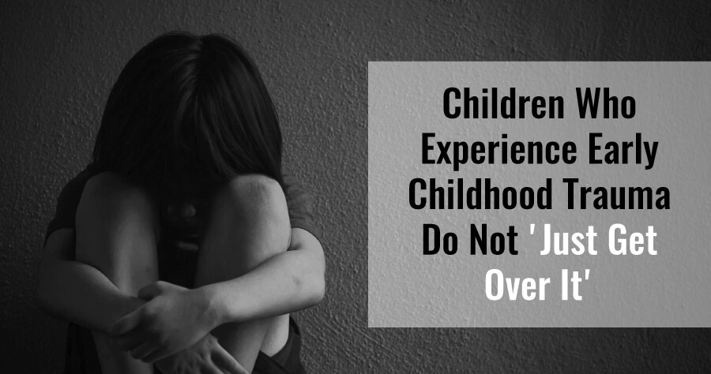
Understanding Trauma

Slide 8

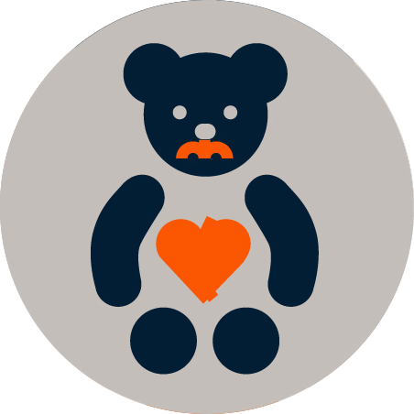
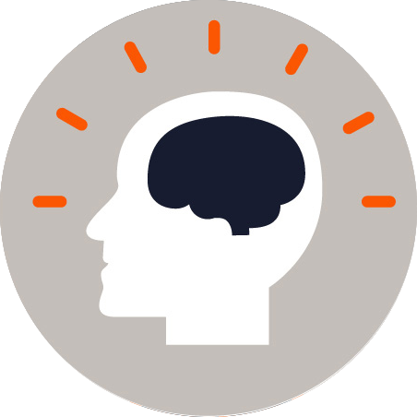
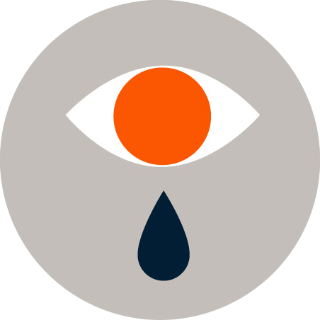

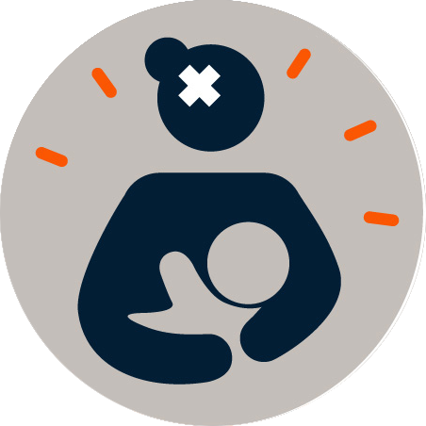





ACES – Adverse Childhood Experiences Study
Three Types of ACEs:
Abuse
Neglect
Household Challenges
Mental Illness
Caregiver Treated Violently (DV)
Divorce
Incarcerated Relative
Substance Abuse
Physical
Emotional
Sexual
Physical
Emotional
Notes:
Discussion on Strength-Based Theory (p.5) – ACEs Study
Kaiser Permanente and Center for Disease Control and Prevention
These are not ALL the types of trauma. Just the ones they asked about.
1995-1997
Almost 18,000 participants – white, educated, older, had jobs and healthcare

Slide 9
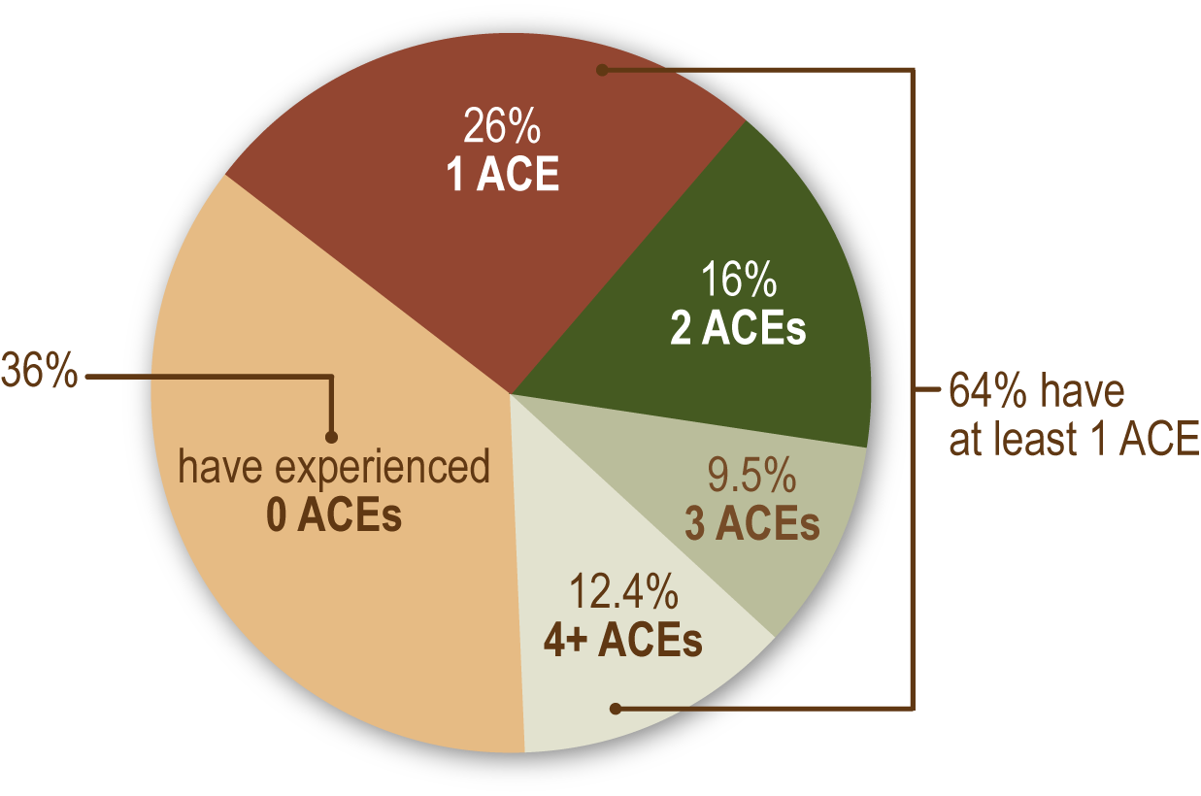
How Prevalent Are ACEs?
Of 17,000 ACE Study Participants
Notes:
Discussion on Strength-Based Theory (p.5) – ACEs Study
1/8th of population have more than 4 ACES
COMMON, they occur together

Slide 10
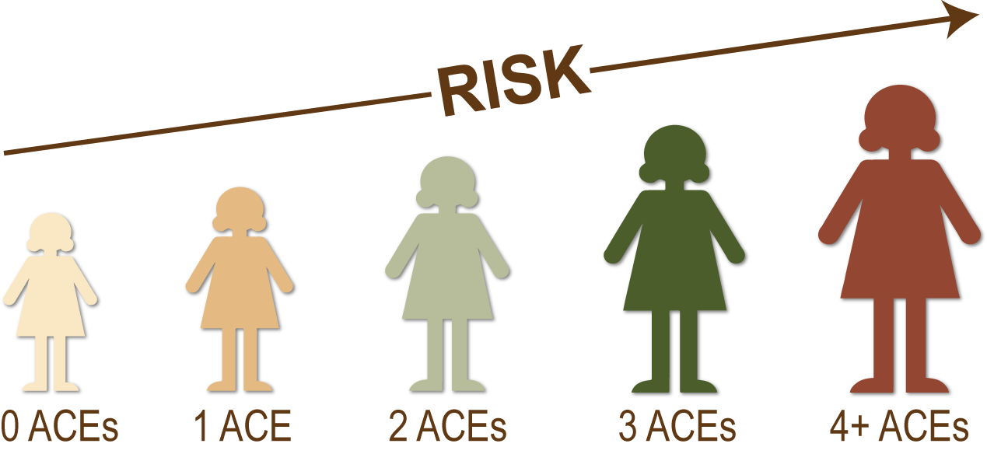
What Impact Do ACEs Have?
As the Number of Aces Increases,
So Does the Risk for Negative Health Outcomes
Notes:
Discussion on Strength-Based Theory (p.5) – ACEs Study
ACES are strongly related to risk factors for disease, well-being, and early death.
More than 1 in 5 people reported 3 or more ACES
DOSE RESPONSE relationship with other health problems. Strong, graded relationship with numerous health, social, and behavioral problems. COMORBID or co-occuring

Slide 11
What Impact Do ACEs Have?
Possible Risk Outcomes Include
Behavior
Lack of Physical Activity
Smoking (at earlier ages)
Alcoholism
Drug Use
Financial issues
Sexual activity at earlier ages (w/ multiple partners)
Adolescent pregnancy
Poor Academic Performance
Poor Work Performance
Risk for DV and sexual violence
Physical and Mental Health
Severe Obesity
Diabetes
Depression
Suicide Attempts
STDs
Heart & Liver Disease
Cancer
Stroke
COPD
Broken Bones
Notes:
Discussion on Strength-Based Theory (p.5) – ACEs Study
COPD – Chronic Obstructive Pulmonary disease
People with 6+ ACES can die 20 YEARS earlier than those who have none.

Slide 12
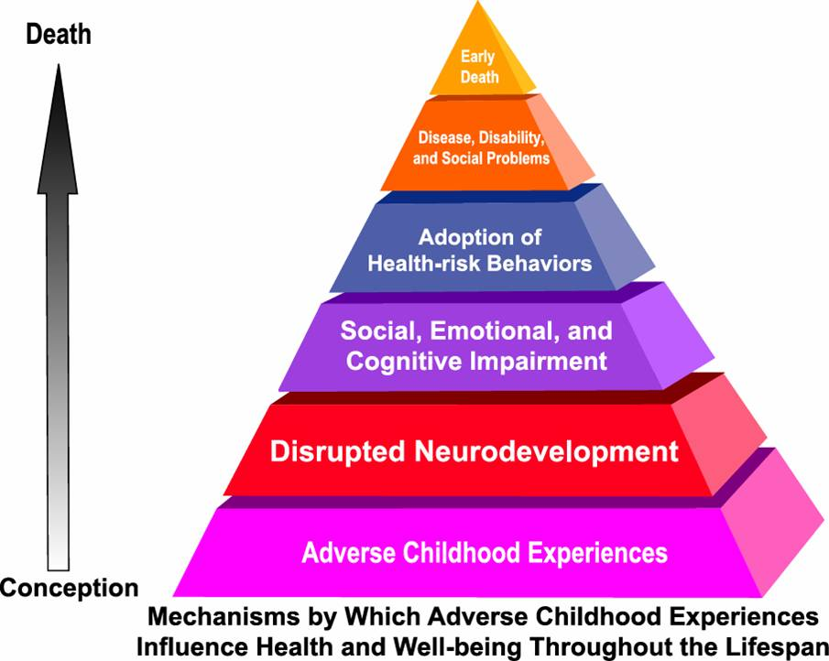
Learn More About the ACE Study
http://www.acestudy.org/home
and
http://www.cdc.gov/violenceprevention/acestudy
“Adverse childhood experiences are the single greatest unaddressed public health threat facing our nation today.”
--Dr. Robert Block, former president of the American Academy of Pediatrics
Notes:
Discussion on Strength-Based Theory (p.5) – ACEs Study
Strong, frequent, prolonged adversity / trauma (ACES) without the buffering of adequate adult support. Toxic stress disrupts brain development.

Slide 13
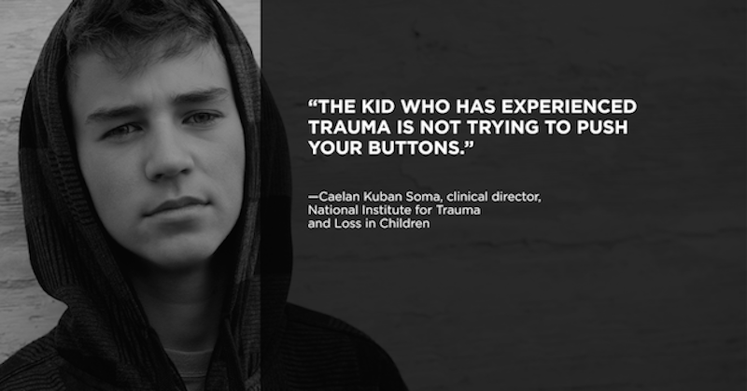
Early Trauma and later behavior
Later Impacts
Hypersensitivity to stressors
Problems with trust, autonomy, and initiative
Difficult interpreting emotional responses
Impulsivity and Continual dysregulation
Patterns of intense, unstable relationships
Trauma effects everyone differently. The TYPE of trauma is not what is important. It is how the individual experienced and perceived the event that matters. Trauma and the trauma response is unique to each person.
Notes:
Exposure to multiple traumatic events, especially over a long period of time, has impact on immediate and long term development.
--positive experiences
--productive decision making, constructive engagement in family, community, school, etc.
--giving them a voice, choice, and personal responsibility
--promote development of self regulation, self reflection, self confidence, self compassion, and character (values)
Features of adolescent brain development:
Slide 37 from 9 from childhood to adolescence

Slide 14
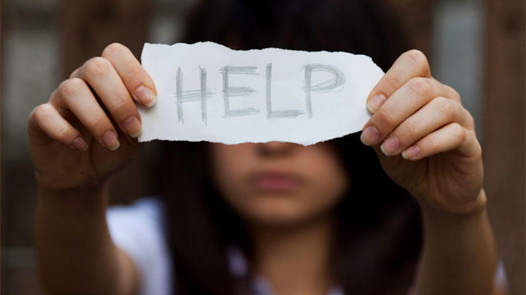
10 things about childhood trauma everyone should know
Kids who have experienced trauma are NOT TRYING to push your buttons
Kids who have been through trauma worry about what is going to happen next
Even if the situation doesn’t seem that bad to you, it’s how the child feels that matters.
Trauma is not always associated with violence.
You don’t need to know exactly what caused the trauma to be able to help.
Adapted from
https://www.weareteachers.com/10-things-about-childhood-trauma-every-teacher-needs-to-know/

Slide 15
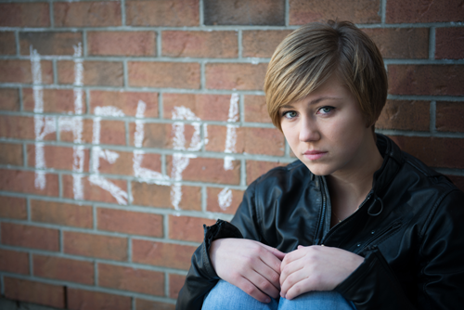
10 things about childhood trauma everyone should know (continued…)
Kids who experience trauma need to feel they are good at something and can influence the world.
There is a direct connection between stress and learning
Self regulation can be a major challenge for students suffering from trauma
It’s OK to ask kids what you can do to help them make it through the day.
You can support kids with trauma by helping them build protective factors, and by educating others about the effects of trauma and the importance of protective factors.

Slide 16
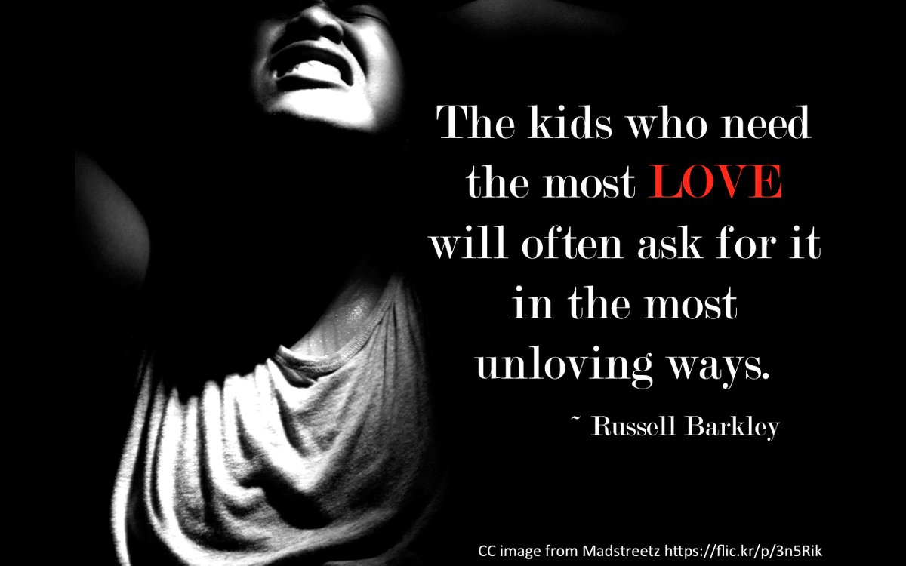
WHAT DO WE DO ABOUT ACES??
PARADIGM SHIFT:
The approach should not be
WHAT IS WRONG WITH YOU?
But instead:
Trauma is just the beginning of the story…
We can give Youth the power to write their own endings.
WHAT HAPPENED TO YOU?
And/or
WHAT DIDN’T HAPPEN TO/FOR YOU?

Slide 17

Protective Factors / Promotive Factors
Protective Factors
Risk Factors
The presence of multiple protective and promotive factors is HIGHLY associated with a decrease in the negative effect of risk factors and the likelihood of involvement in problem behaviors.
Notes:
The five protective factors at the foundation of Strengthening Families are characteristics that have been shown to make positive outcomes more likely for children and their families, and to reduce the likelihood of child abuse and neglect.
Strengthening Families™ is a research-informed approach to increase family strengths, enhance child development and reduce the likelihood of child abuse and neglect. It is based on engaging families, programs and communities in building five key protective factors. At its heart, Strengthening Families is about how families are supported to build key protective factors that enable children to thrive. The five protective factors at the foundation of Strengthening Families also offer a framework for changes at the systems, policy and practice level – locally, statewide and nationally.
--Informed by research. CSSP Looked at all existing literature and conducted interviews with those working with children ad families. In addition to the literature review, CSSP wanted to make sure that the approach was informed by practice experience. To make sure that Strengthening Families incorporated the knowledge and values of workers across the country, CSSP hosted dialogue sessions with key partners nationwide. These dialogue sessions, coupled with literature review and input from the National Advisory Committee, were used to inform and develop the understanding of the five protective factors
--solicited programs to put this into action. Built them into the day to day work. Site visits and parent focus groups.
--Selected and piloted the framework in 7 states
--Created a learning network. Expanded to many child and family serving arenas. Using the Strengthening Families framework, more than 30 states are shifting policy and practice to help programs and providers working with children and families to take everyday actions that support parents to build their protective factors. States apply the Strengthening Families approach in early childhood, child welfare, child abuse prevention and other child and family serving systems.

Slide 18

Risk, Protective, and Promotive Factors
Protective Factors:
Conditions or attributes that reduce of eliminate the effect of risk factors
Risk Factors:
Conditions or attributes that increase the probability of poor outcomes
Promotive factors:
Conditions or attributes that actively enhance well-being
Notes:
What are some examples?

Slide 19

Paul Smith – typerwriter artist
Insert Paul’s video
https://www.youtube.com/watch?v=svzPm8lT36o&t=74s
Notes:
Video: Amazing Typewriter Artist – (not referenced in the TM, but appropriate to support the discussion on Strength-Based Theory p.5)
focusing on what is strong – not what is wrong. The artist points out that he focused on what he was able to do – “what can you do?”

Slide 20


Youth Thrive Framework
Youth Thrive is a research based approach that uses the latest science to identify protective and promotive factors that increase the likelihood that adolescents can develop into healthy, thriving adults.(Center for the Study of Social Policy)
Strengths based – all youth have strengths. Identifying and building on a youth’s strengths is essential.
Trauma informed – be aware of how adverse childhood experiences can have immediate, long term, and enduring effects

Slide 21
Youth Thrive Protective and Promotive Factors
Youth Resilience
Positive Social Connections
Knowledge of Adolescent Development
Concrete Support in Times of Need
Cognitive and Social-Emotional Competence

Slide 22

resilience
TELL THEM WHAT THEY ARE DOING RIGHT!
Notes:
What it looks like:
Resilience to general life stress • Hope, optimism, self confidence • Problem solving skills • Self care and willingness to ask for help • Ability to manage negative emotions
No one can eliminate stress from their lives, but a person’s capacity for resilience can affect how they deal with stress. Resilience is the ability to manage and bounce back from all types of challenges that emerge in everyday life. It means finding ways to solve problems, building and sustaining trusting, and knowing how to seek help when necessary.
**Best way to build Resilience? Tell people what they are doing well, both in the present and the past.
Everyday actions:
• Demonstrate in multiple ways that person is valued, help them see their strengths
• Honor each family’s race, language, culture, history and approach to parenting
• Encourage students / parents to manage stress effectively
• Support students / parents as decision-makers and help build decision-making and leadership skills
Help student build coping skills / help parents understand how to buffer their child during stressful times

Slide 23

Social Connections
QUALITY NOT QUANTITY.
Research supports that the single biggest thing that helps kids recover from trauma and maltreatment is a stable, supportive adult, who believes in them, supports them, and models & teachers effective coping.
Notes:
Social Connections:
Positive relationships that provide emotional, informational, instrumental and spiritual support. Friends, family members, neighbors and community members provide emotional support, help solve problems, offer advice and give concrete assistance. Networks of support are essential and also offer opportunities for people to “give back”, an important part of self- esteem as well as a benefit for the community. Isolated individuals may need extra help in reaching out to build positive relationships.
What it looks like
• Multiple friendships and supportive relationships with others
• Feeling respected and appreciated
• Accepting help from others, and giving help to others
• Skills for establishing and maintaining connections
Everyday actions
• Help families value, build, sustain and use social connections
• Create an inclusive environment
• Facilitate mutual support
• Promote engagement in the community and participation in community activities
**Thing to remember: Looking for QUALITY not QUANTITY
(Youth) expressed a strong desire to have authentic relationships with adults with whom they connect and feel comfortable," the report said. "They sense that adults are fearful of saying the wrong thing and, unfortunately, this leads to no conversation about suicide at all, or an intense reaction where conversations feel like an inquisition of one's potential suicidality."

Slide 24

Knowledge of Development
(especially brain development)
Realistic expectations.
Bad behavior a bad kid.
Trauma effects brain development.
All youth have strengths!
Notes:
Knowledge of Parenting and Child Development:
Understanding child development and strategies that support physical, cognitive, language, social and emotional development. Accurate information about child development and appropriate expectations for children’s behavior at every age help adults see their children and youth in a positive light and promote their healthy development.
Information can come from many sources, including family members as well as parent education classes and surfing the internet. Studies show information is most effective when it comes at the precise time parents need it to understand their own children. Parents who experienced harsh discipline or other negative childhood experiences may need extra help to change the parenting patterns they learned as children.
**Help parent’s recognize when they have unrealistic expectations for their child, help children recognize other’s developmental needs.
What it looks like
• Nurturing behavior
• Appropriate developmental expectations
• Ability to create a developmentally supportive environment for child
• Positive discipline techniques; ability to effectively manage child behavior
• Recognizing and responding to child’s specific needs

Slide 25
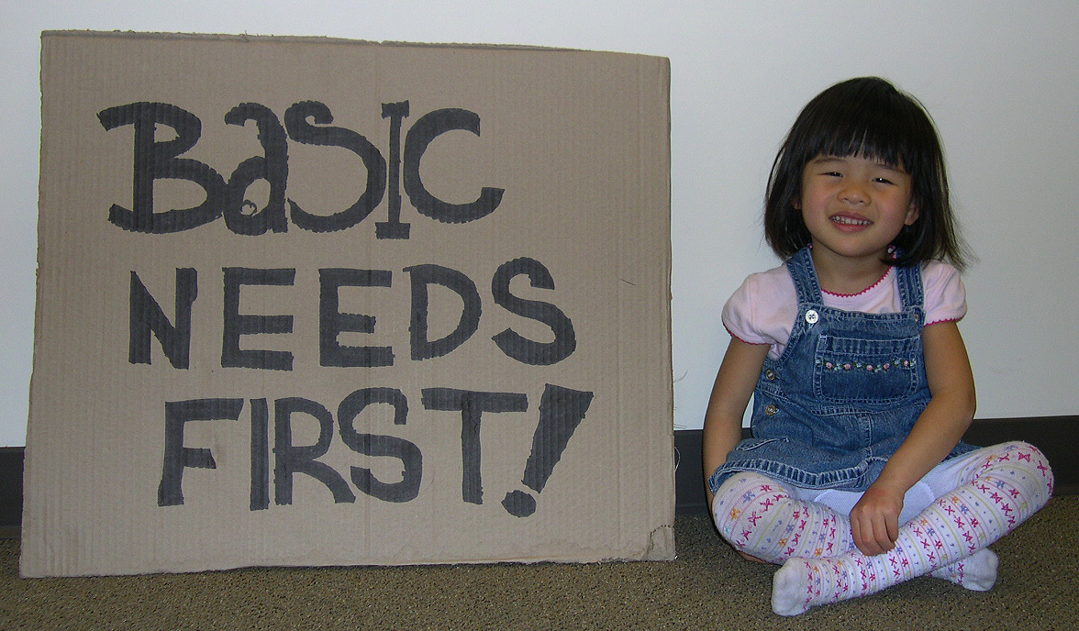
Concrete Supports in Time of need
Seeking help is a strength, not a weakness.
Help them learn to advocate for themselves.
Notes:
Concrete Supports in times of Need:
Access to concrete support and services that address a family’s / student’s needs and help minimize stress caused by challenges. Meeting basic economic needs like food, shelter, clothing and health care is essential for families to thrive. Likewise, when families encounter a crisis such as domestic violence, mental illness or substance abuse, adequate services and supports need to be in place to provide stability, treatment and help for family members to get through the crisis.
What it looks like
• Seeking and receiving support when needed
• Knowing what services are available and how to access them
• Adequate financial security; basic needs being met
• Persistence
• Advocating effectively for self and child to receive necessary help
Maslow’s hierarchy of needs
**Remember: Seeking help is a strength, not a weakness. Help them advocate for themselves.

Slide 26
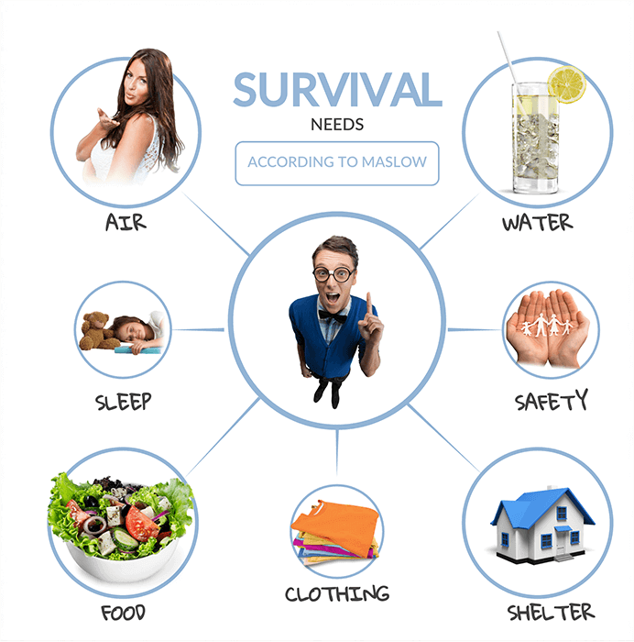
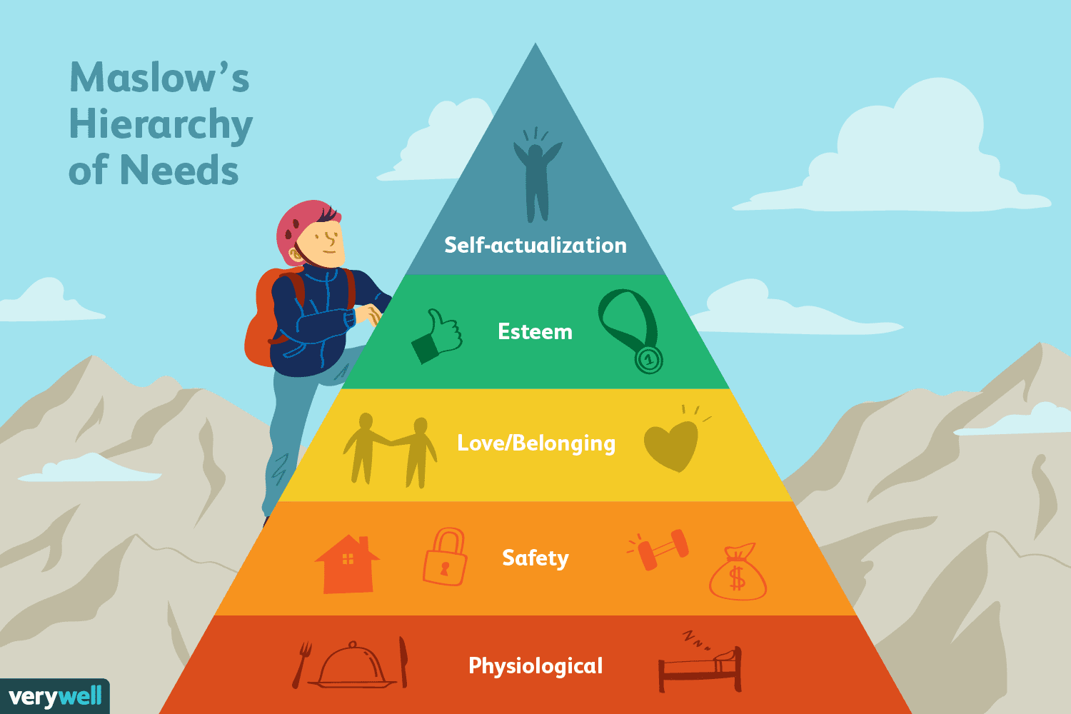
Notes:
Theory of human motivation
Abraham Maslow proposed that healthy human beings have a certain number of needs, and that these needs are arranged in a hierarchy, with some needs (such as physiological and safety needs) being more primitive or basic than others (such as social and ego needs). If needs are not met, person becomes anxious. It is very difficult to move up the pyramid if lower level needs are not met.
Physiological – food, air, water, shelter, sleep, clothing, warmth
Safety – health, shelter, resources, not fearful or traumatized, security, stability
Love & belonging – friendship, intimacy, family, sense of connection. inclusion
Esteem – respect, self-esteem, recognition, strength, freedom, accomplishment
Self actualization – desire to learn and become the most one can be, creativity, full potential.
Everyday actions
• Respond immediately when families are in crisis
• Provide information and connections to services in the community
• Help families to develop skills and tools they need to identify their needs and connect to supports

Slide 27

Cognitive and Social-Emotional Competence
Windows of Tolerance
“Fight, Flight, Freeze”
Self regulation (Coping) Skills are important
Notes:
Social and Emotional Competence of Children:
Family and child interactions that help children develop the ability to communicate clearly, recognize and regulate their emotions and establish and maintain relationships.
A students ability to interact positively with others, self-regulate their behavior and effectively communicate their feelings has a positive impact on their relationships with their family, other adults, and peers. Challenging behaviors or delayed development create extra stress for families, so early identification and assistance for both parents and children can head off negative results and keep development on track.
Example: A child who generally shows the ability to control their impulses, calm themselves down, manage their stress, and show love and kindness towards others.
Age appropriate self-regulation
• Ability to form and maintain relationships with others
• Positive interactions with others
• Effective communication
FLIGHT, FIGHT, FREEZE – Coping skills
Everyday actions:
Warm and consistent responses that foster a strong and secure attachment with the child
Encouraging and reinforcing social skills; setting limits
Include children’s social and emotional development activities in programming
Help children develop a positive cultural identity and interact in a diverse society
Respond proactively when social or emotional development needs extra support
**Remember: Difficult children are harder on parents and teachers.

Slide 28
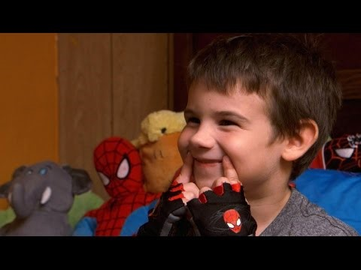
An example of Protective Factors: Jaden smiles
https://www.youtube.com/watch?v=OCPc2RlMTII

Slide 29
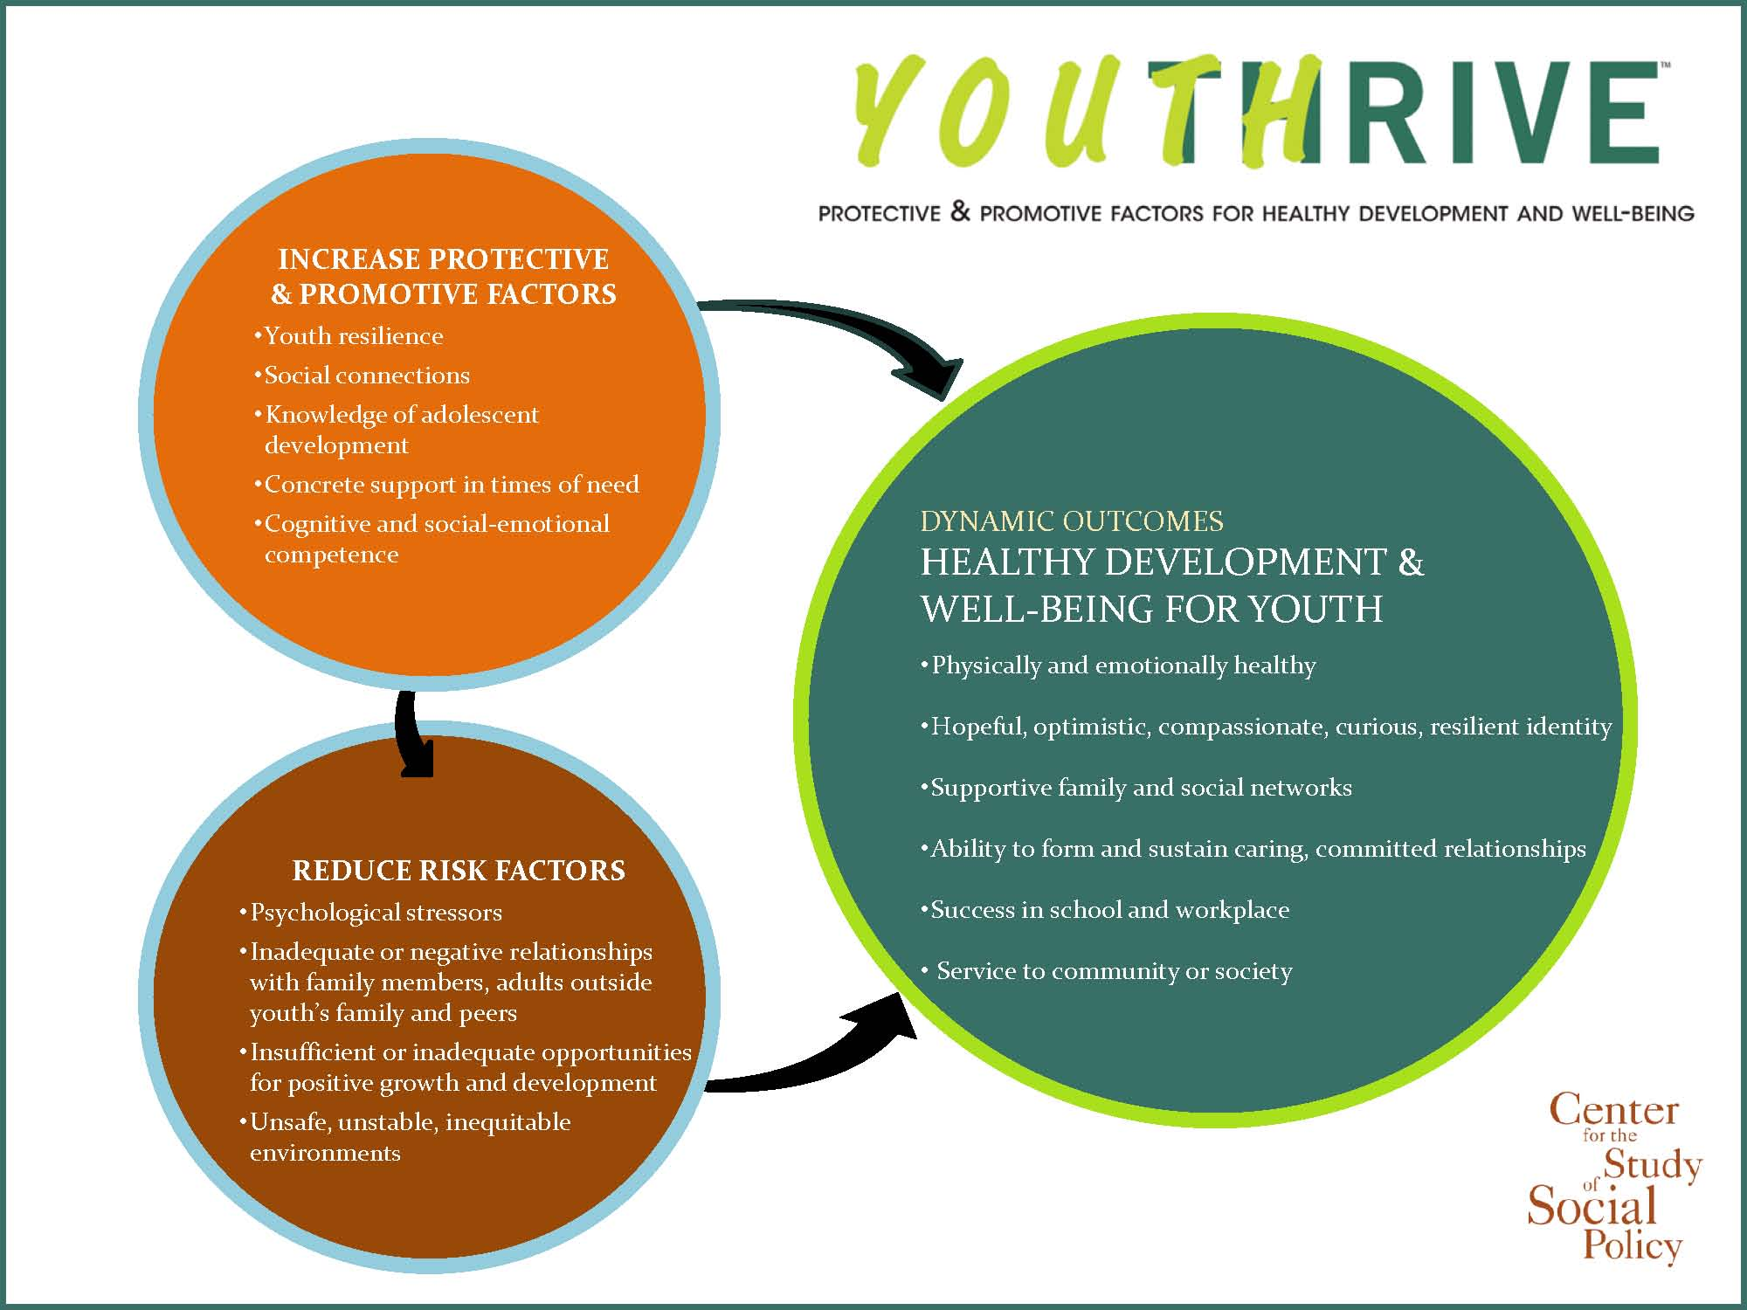
Learn More About Youth thrive
https://www.cssp.org/reform/child-welfare/youththrive

Slide 30
Learn More About the Protective Factors
Explore the Alliance online training – with a course on each Protective Factor – free of charge on the Alliance website:
http://ctfalliance.org/onlinetraining.htm
Discover resource materials about the Protective Factors on the Center for the Study of Social Policy website:
http://www.cssp.org/reform/strengtheningfamilies/
about#protective-factors-framework
        Research briefs about each Protective Factor
        Core meanings of the Protective Factors
        PowerPoint slides about the Protective Factors
        The research behind the Protective Factors
Notes:
Defining the PFs – (p.7)

Slide 31
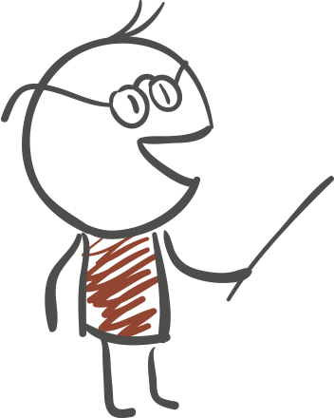
Protective Factors Are Dependent on Culture
As we consider each Protective Factor, ask yourself these three questions:
How does the culture of a family impact this Protective Factor?
How does your own culture shape how you feel, how you react and what you say or think?
How does culture impact what and how you are teaching?
Notes:
Culture and Family Strengths (p. 13)
The Importance of Culture (p.13)

Slide 32
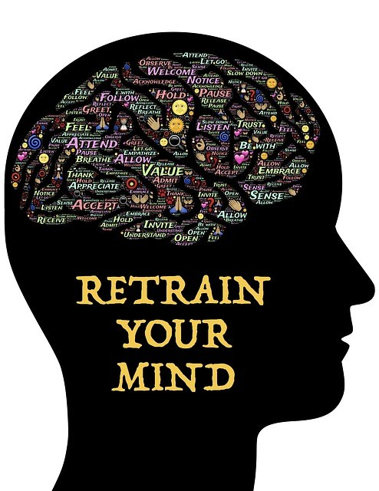
Raising Positivity = Happiness Advantage
When brain is positive:
  Performs better than negative, neutral, or stressed brain (Happy people solved 20% more word puzzles than unhappy people in one study)
  Intelligence rises, creativity rises, energy rises
  Brain is 31% more productive
  Chemical rush makes you happy and turns on all learning centers in the brain, allowing you to adapt to the world and see different perspectives
  (We turn outward and view things as less stressful!)

Slide 33

Benefits of Happy Thoughts
An avalanche of studies have shown that happy thoughts, no matter the source, lead people to be more productive, more likable, more active, more healthy, more friendly, more helpful, more resilient, and more creative.

Slide 34

Raising Positivity = Happiness Advantage
Do any of the following, 2 min/day for 21 days to rewire your brain for more positivity
  3 gratitudes – trains the brain to scan for positives
  3 extra smiles (10:5 rule) – releases dopamine, improves mood, contagious
  Journaling about 1 positive experience in the last 24 hours – allows your brain to relive it and remember it; lowers levels of worry and pessimism
  ;
  Exercise – teaches your brain that your behavior matters, decreases anxiety/worry
  by 20%!
  Meditation – allows your brain to slow down and focus on the task at hand
  Random acts of kindness – doing good leads to feeling good, ripple effect; first observe, then serve
Notes:
10:5 rule is when you are within 10 feet of someone, SMILE. When you are within 5 feet, say HELLO.
Ted talk: Kelly McGonigal How to make stress your friend

Slide 35


Quick Stress Tips to Remember
Power of 3s:
Will ___ matter in 3 hours? 3 days? 3 months? 3 years?
Tone of voice influences how our message is received.
Irritation is an invitation… (e.g. compassion, understanding,
slow down and see things differently).
Remember children (and adults) do things that make
sense to them.
People matter more than problems, projects, and test scores.
How we choose to RESPOND changes everything
Keep my cool when things heat up!

Slide 36

THANK YOU!!!
Tanya Albornoz
Foster Care and Community Program Administrator
Protective Factors for Utah Families Certified Trainer
talborno@utah.gov
801-696-4866

